Slide 1
MATLAB image anaysis
Josh Yeh

Slide 2
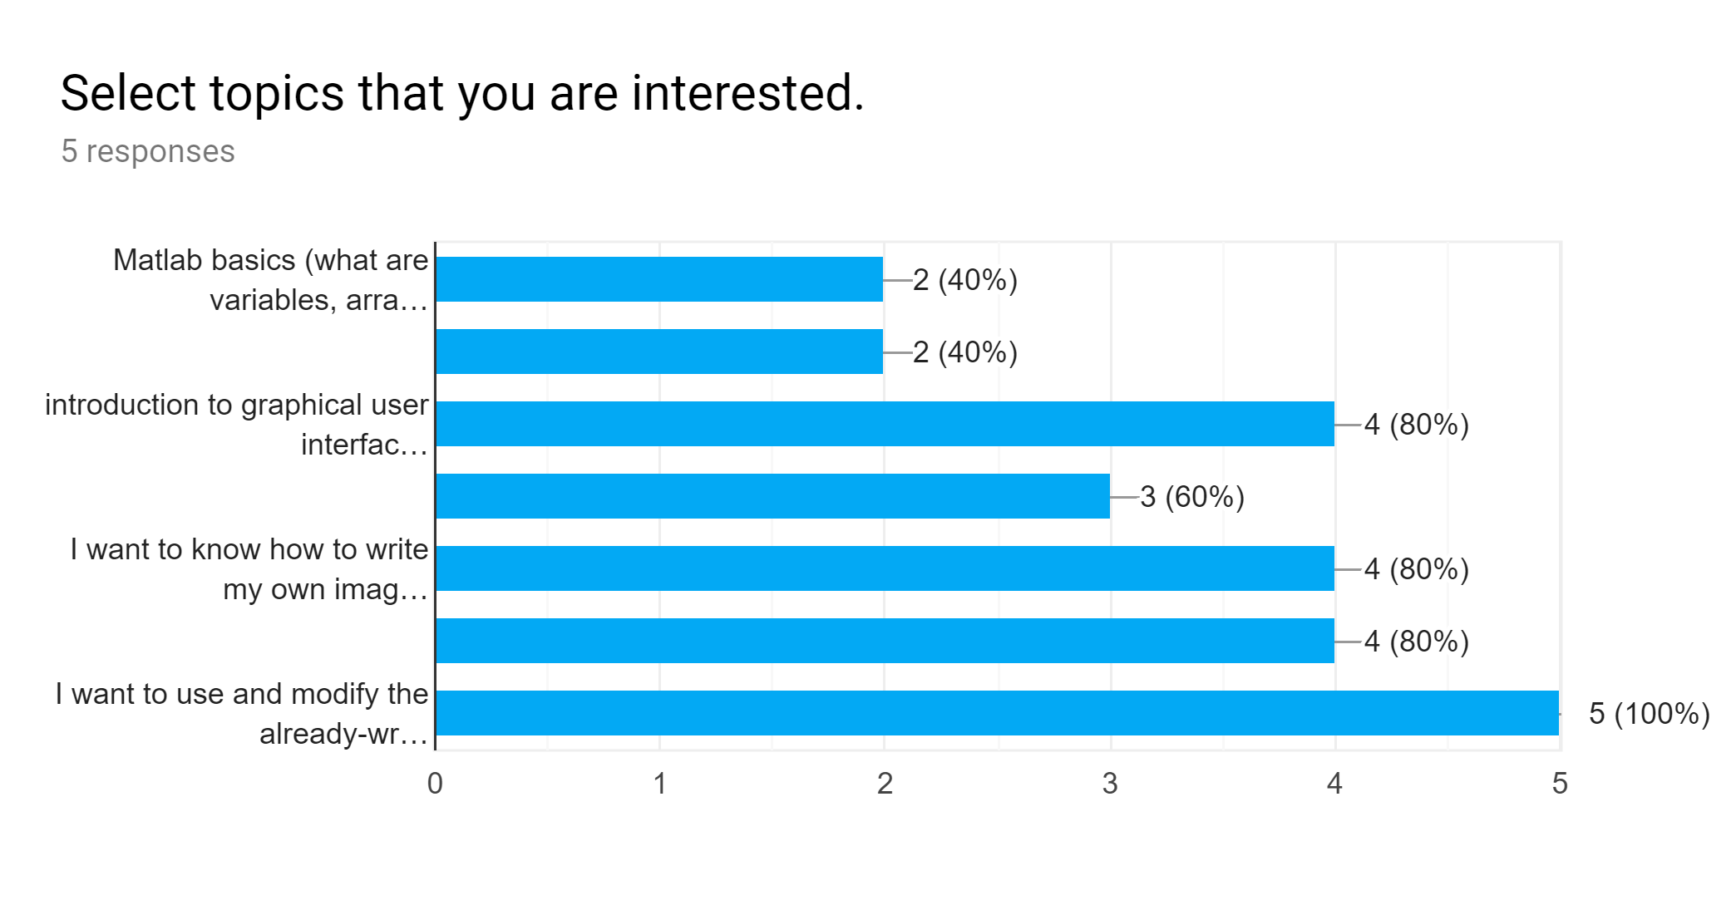
results from google survey topics of interest…
MATLAB basics
workflow
GUI
plotting
write my own scripts
manip. prewritten scripts for sp
manip. prewritten scripts for DA

Slide 3
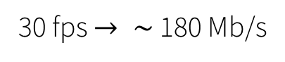

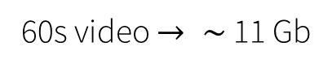
Computer and MATLAB basics (what you need to know)
image analysis can be resource intensive
uncompressed RGB 8-bit image $→ \sim$ 6 Mb
512 px
30 fps $→ \sim$ 180 Mb/s
60s video $→ \sim$ 11 Gb
512 px
ideal computer specifications for image analysis
i7 quad-core with at least 6MB cache size (the brain of the computer)
16 GB RAM (Random Access Memory) (items on your desk)
>1 TB storage (Random Access Memory) (items in the file cabinet)
256 GB SSD storage to run Windows 10 and MATLAB
dedicated Nvidia graphics card (useful for visualizing 3D or 4D plots)

Slide 4
image basics
col
0
x
color depth
8-bit: 0-255
12-bit: 0-4095
16 bit: 0-65535
row
y

Slide 5
image formats
currently raw, uncompressed tiff images and raw, uncompressed avi 2.0 are implemented in the scripts
2 types of compression:
1) loss-less (more efficient way of storing data)
2) lossy (loss of information)
How images are compressed are often proprietary…
no information is lost for uncompressed images, but image size will be large

Slide 6
Work flow
image collection
pre-processing
(corrections, etc.)
analysis
results
MATLAB scripts
depend on similar functions
create your own!
GitHub
maintain version control

Slide 7
GitHub
erc-chemech/Nikon_stitch_GUI
MATLAB functions
Master copy
changes are approved and implemented
download
functions and sync
propose changes

Slide 8
Setting up MATLAB with Github library
Create/sign-in to your Github account
Download Github desktop program
Subscribe and download repository (library):
https://github.com/erc-chemech/image-processing-MATLAB
Create a startup.m file in your “C:/Documents/MATLAB” folder
Add the library path to startup.m
e.g. addpath(‘C:/Documents/GitHub/image-processing-MATLAB’);
Make sure to download all available toolboxes

Slide 9
startup.m example
%Script that runs at startup
clc;
disp(date);
addpath('F:\Dropbox\ESPCI-Paris\MATLAB\image-processing-MATLAB');
disp('Startup script for Josh initiated!');

Slide 10
Overview of image-processing-MATLAB library
image analysis
fitting
plotting
misc.
dist_dsearch.m
fminsearchbnd.m
numerFminS.m
sp_crack_map_LU/TLS_refine.m
sp_crack_map_LU/mypoly2.m
center_axes.m
gen_labels.m
histfit_mod.m
my_color_gradient.m
my_fig.m
shadedErrorBar.m
subtightplot.m
xylabels.m
xyzlabels.m
sp_crack_map_L/alphaColorbar.m
sp_crack_map_L/alphaColorbar_stacked.m
sp_crack_map_L/honeycomb.m
sp_crack_map_L/my_hist2.m
sp_crack_map_L/my_honeycomb.m
sp_crack_map_LU/alphaColorbar.m
sp_crack_map_LU/alphaColorbar_stacked.m
sp_crack_map_LU/honeycomb.m
sp_crack_map_LU/my_hist2.m
sp_crack_map_LU/my_honeycomb.m
sp_crack_map_LU/ G_RGB_mod_space.m
sp_crack_map_LU/overlay_axes.m
Argolight.m
bin_data_array.m
coord2image.m
extract_frames.m
gen_sf_array.m
import_tiff_stack.m
play_frames.m
px_coord2image.m
rgb_correction.m
rgb_ratio.m
DA_image_analysis/corrections.m
DA_image_analysis/DA_ROI.m
DA_image_analysis/ex_subl.m
DA_image_analysis/mask_denoise.m
sp_crack_map_L/parse_sp_crack02b.m
sp_crack_map_LU/parse_sp_crack02.m
sp_crack_map_LU/gen_unload_array.m
findobj.m
sp_crack_map_L/my_dcm
sp_crack_map_L/getErr.m
sp_crack_map_LU/my_dcm
sp_crack_map_LU/getErr.m
sp_crack_map_LU/my_dcm_callback.m
functions are well commented

Slide 11
Performing image analysis for DA, bond breakage experiments
image correction
noise removal
image stitching
Performing image analysis for spiropyran color analysis
step cyclic loading test
color mapping
crack tip mapping

Slide 12
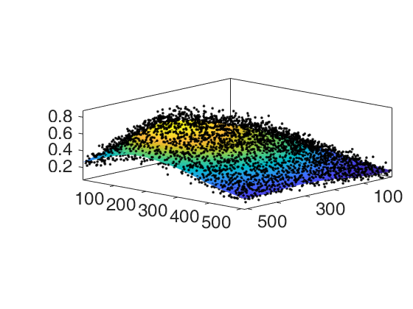
Image analysis (DA experiments)
image correction
flatfield correction
Obtain homogeneous samples containing activated DA mechanophore in PEA.
flatfield correction array
(divide image by this array to get corrected image)
calibration files
flatfield.m
flatfield.m demonstration

Slide 13

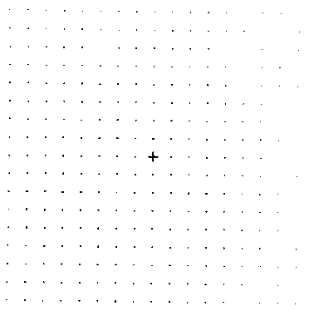
Image analysis (DA experiments)
image correction (Argolight)
x-y distortion
Argolight.m
Argolight calibration fluorescent dots
(with known spacing)

Slide 14
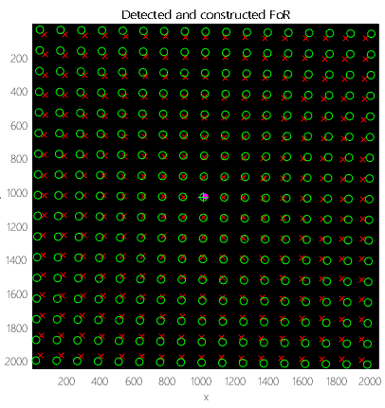
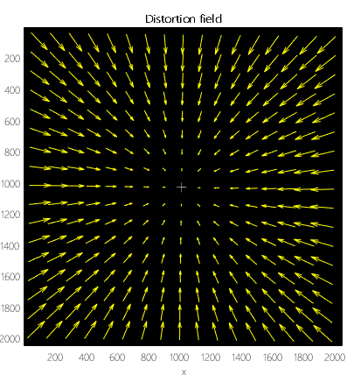
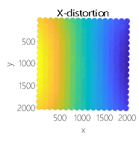
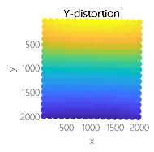
Image analysis (DA experiments)
image correction (Argolight)
x-y distortion
input calibration image
Argolight.m
x-y distortion
identify grid points
rotation correction
determine distortion

Slide 15
Image analysis (DA experiments)
image correction (Argolight)
flatfield correction
generally not recommended
due to stage/sample tilting issues and Moiré effects
Argolight demonstration

Slide 16
Image analysis (DA experiments)
image correction
general approach
Extract image (import_tiff_stack)
2) Perform flatfield correction (flatfield.m)
3) Perform distortion correction (Argolight.m)
convert image to xy coordinates
4) Perform 2d histogram binning
convert xy coordinates to image

Slide 17
Image analysis (DA experiments)
noise removal
Use medfilt2 on image array (takes median value within an m by n array around the pixel.
lose image resolution
Use mask_denoise instead
1) medfilt2 on image array
2) binarize the image
3) perform further denoising operations on binary mask
4) apply mask to original image
remove noise
maintain original resolution
identify sample edge
denoising demonstration

Slide 18
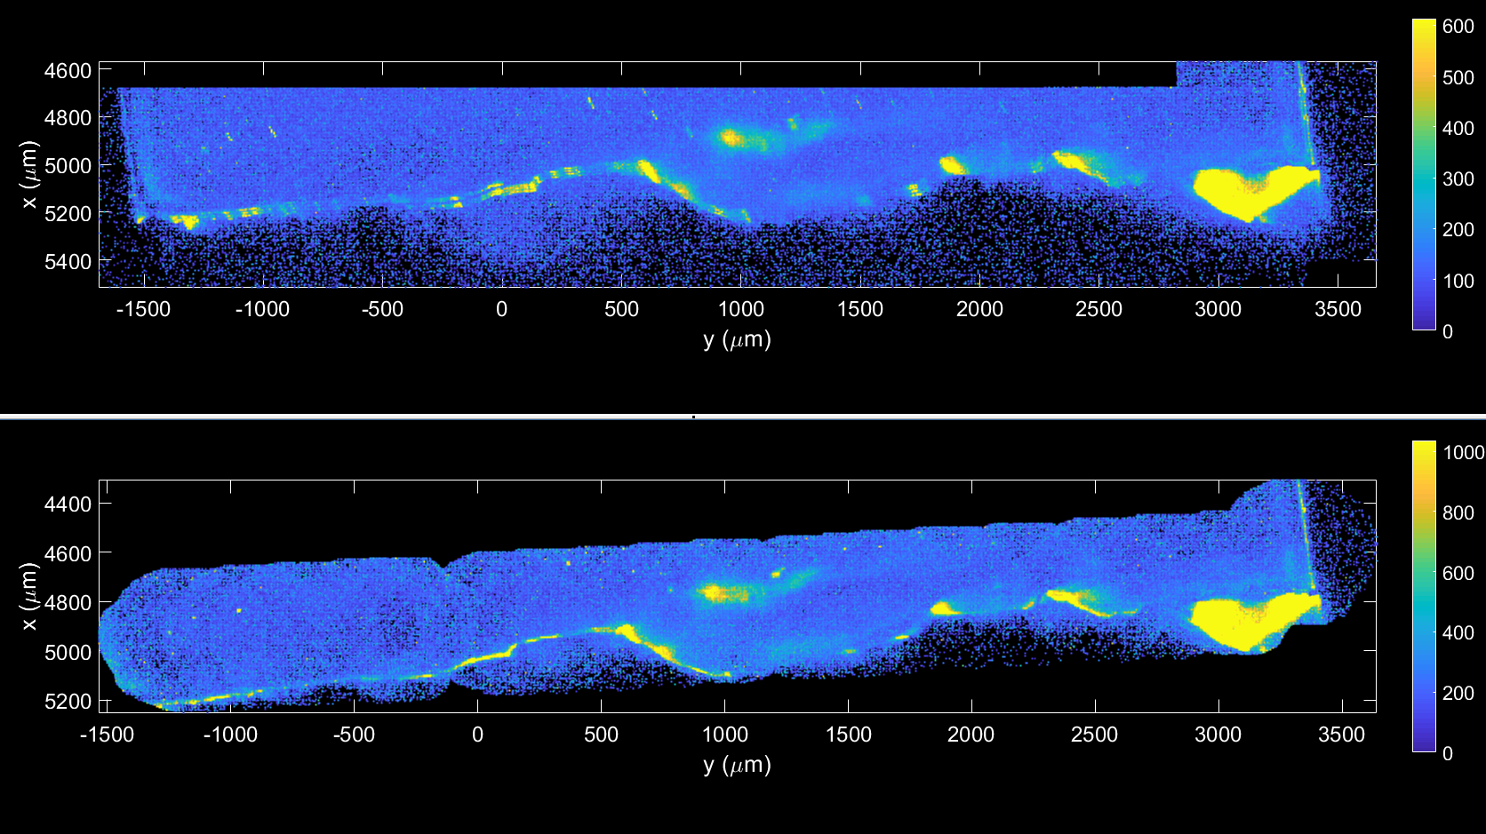
Image analysis (DA experiments)
image stitching

Slide 19
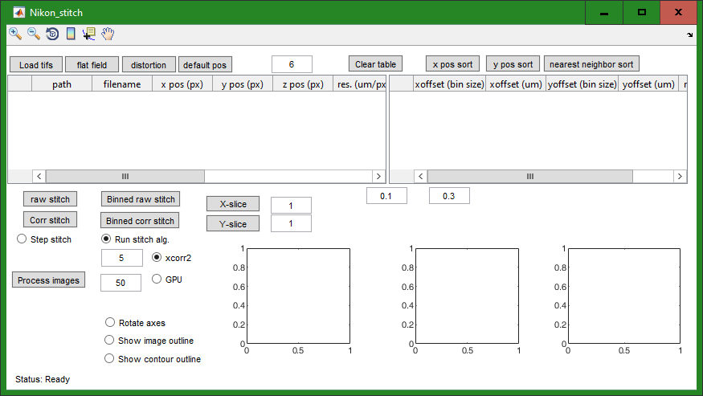
Image analysis (DA experiments)
image stitching GUI
https://github.com/erc-chemech/image-processing-MATLAB

Slide 20
Performing image analysis for DA, bond breakage experiments
image correction
noise removal
image stitching
Performing image analysis for spiropyran color analysis
step cyclic loading test
color mapping
crack tip mapping

Slide 21
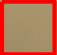

Image analysis (sp experiments)
step cyclic loading test
Define region as a “white reference”
Unimportant whether the white reference is “truly” white, since only relative color change is important.
Perform color correction
Rescale and re-center RGB values
Needed in order to compare color changes between different samples

Slide 22
Image analysis (sp experiments)
step cyclic loading test
Perform color correction
Rescale and re-center RGB values
Needed in order to compare color changes between different samples

Slide 23
Image analysis (sp experiments)
step cyclic loading test
Why not re-center channels at a value of 255?
This is to prevent saturated pixels when displaying the corrected image.
It does not matter what value you center at, since the values are normalized by the sum of the 3 channels (RGB ratio)
Quantify color change with RGB ratio
R or G or B
R+G+B
Derivable from Grassman’s Law from colorimetry

Slide 24
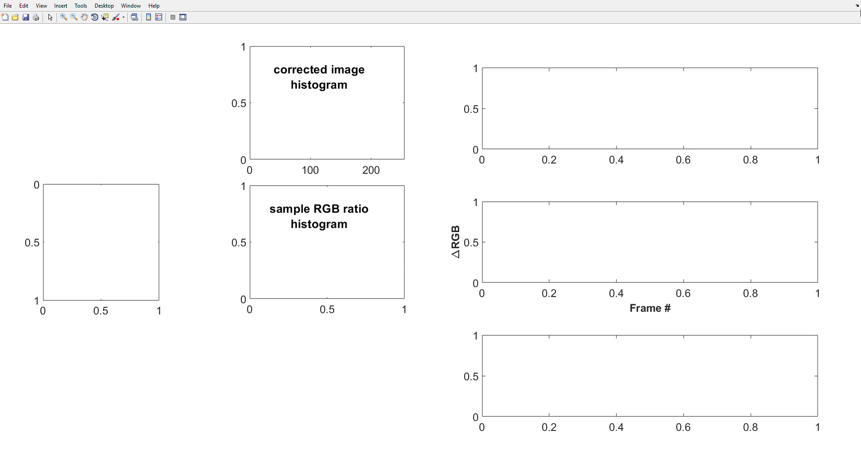
Image analysis (sp experiments)
step cyclic loading test
Identify region-of-interest (ROI)
Based on black markings on sample
Perform calculations (mean, stdev, etc.)
soon to be incorporated into library…
step cyclic loading demonstration

Slide 25
Image analysis (sp experiments)
color mapping
associate color with applied stress (complicated…)
soon to be incorporated into library…

Slide 26
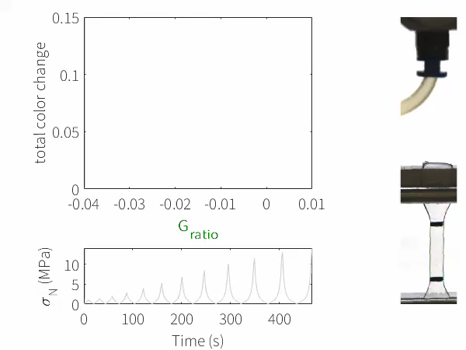
virgin loading
virgin loading
unloading
reloading
no color
~1.7 MPa
8x speed
Notes:
So, let’s go back to the step cyclic experiment that I showed you from before. This time I will show you a synchronized color analysis. Since we only need 2 descriptors, we can describe the color changes with the total color change and the change in the green chromaticity. The choice for these 2 descriptors are semi-arbitrary, but the choice is based on the idea that the total color change represents the total “signal” given by the activation of the mechanophore and the observation that the green chromatic change is particularly sensitive to the unloading process of the sample.

Slide 27
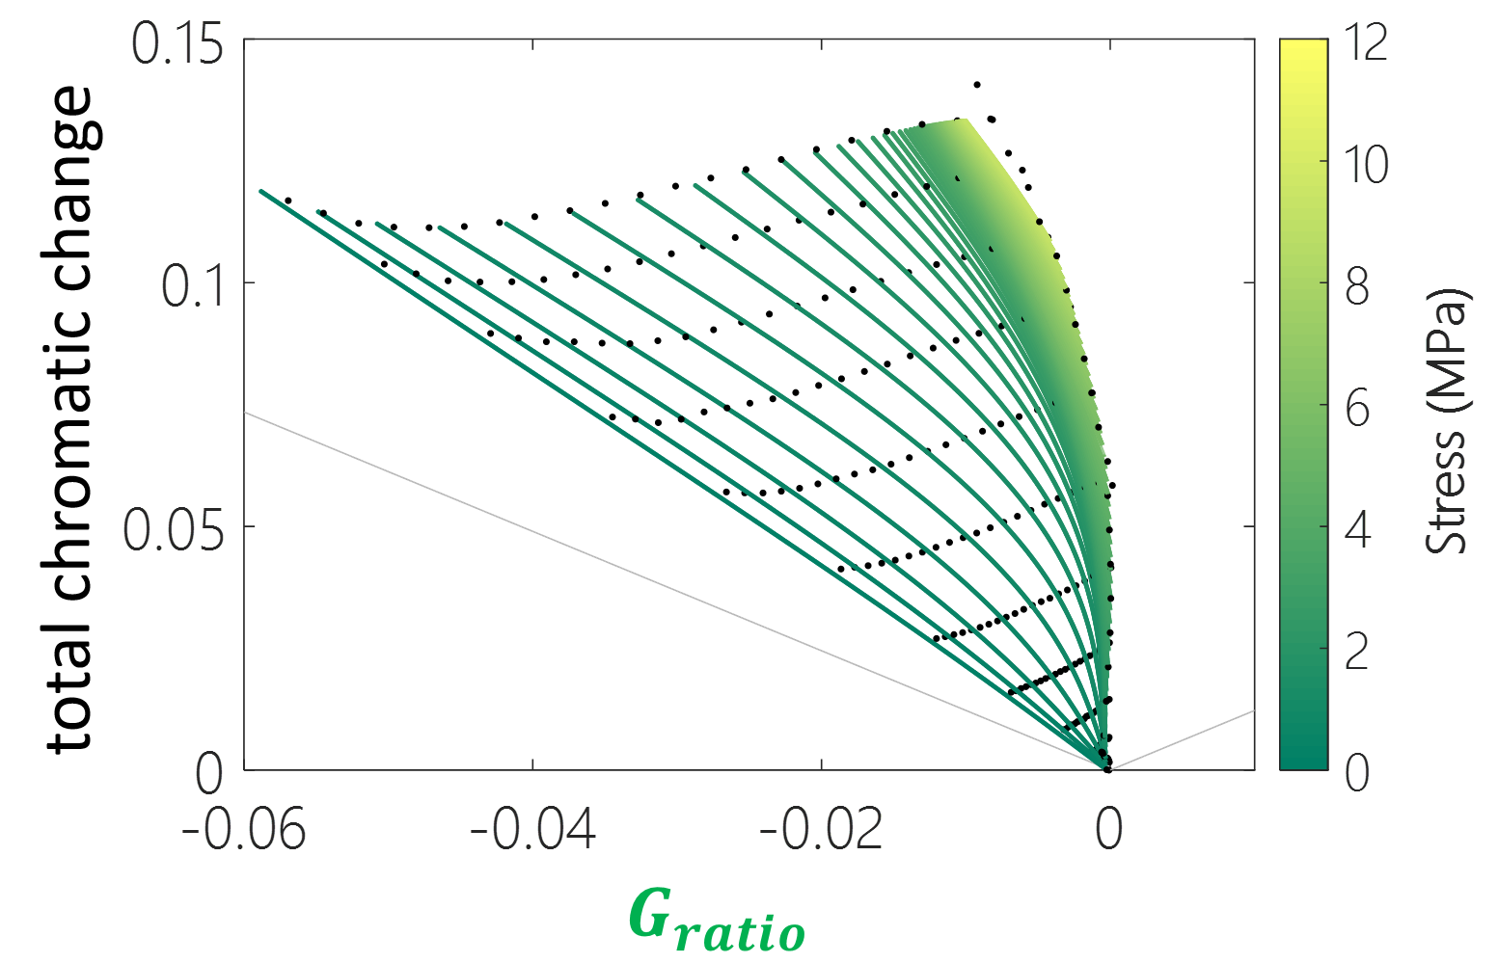

reloading
virgin loading
Stress (MPa)
total chromatic change
unloading
$$G_{ratio}$$
Notes:
Simplified, labeled color map
Introduce isostress lines to create color-stress maps. (calibration map)
Based on the correlation, to back-calculate the associated stress for a given color.
Parse pixels as unloading vs. loading and determine the loading history for an unloaded pixel

Slide 28
Image analysis (sp experiments)
color mapping
synchronized and interpolated with video data
MATLAB “spline” fcn
Instron data

Slide 29
Image analysis (sp experiments)
color mapping
fit unloading/loading curves to chromatic points
3rd order polynomial
total least squares method
takes into account uncertainty in both x and y
numerFminS fcn
fit the fit parameters to interpolate

Slide 30
Image analysis (sp experiments)
color mapping
fit unloading curves to stresses
linear least squares method

Slide 31
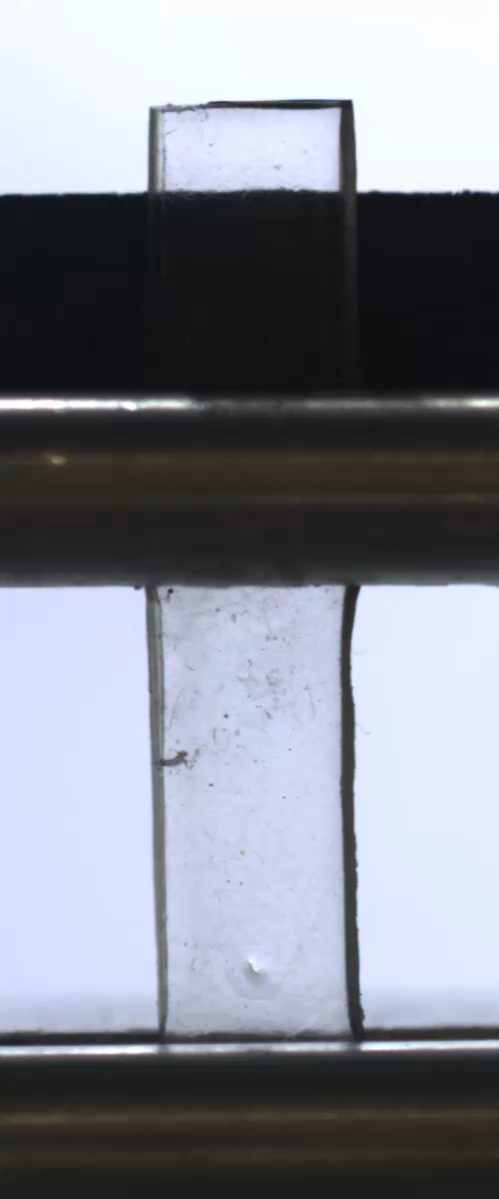
Image analysis (sp experiments)
color mapping

Slide 32
Image analysis (sp experiments)
crack tip mapping
parse_sp_crack02 fcn (also very complicated)
color
stress values
loading vs. unloading

Slide 33
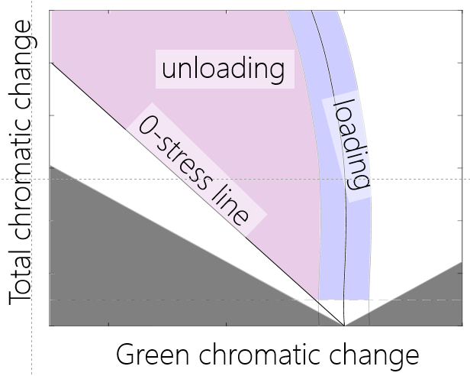
Image analysis (sp experiments)
crack tip mapping
loading vs. unloading
loading stresses are determined by closest orthogonal distance along the loading line

Slide 34
Image analysis (sp experiments)
crack tip mapping

Slide 35
Performing image analysis for DA, bond breakage experiments
image correction
noise removal
image stitching
Performing image analysis for spiropyran color analysis
step cyclic loading test
color mapping
crack tip mapping

